Slide 1

Low Frequency Electromagnetic Coupling:
Shielded Wires, Twisted Wires
F. Rachidi
École Polytechnique Fédérale de Lausanne
EMC Laboratory
Farhad.Rachidi@epfl.ch
http://emc.epfl.ch

Slide 2
Effect of shield
We replace the receptor wire by a shielded cable.
The induced voltage reduces
Only the inductive coupling is reduced
The effect of the shield depends on the line configuration
None of the above

Slide 3
General Methods of Reducing Low-Frequency Interference
The generalized equivalent circuit for calculating low-frequency interference of a victim circuit suggests several methods for reducing the effects of the interference on the victim circuitry. These are as follows:
  reduce the EMI signal strength Vs,
  reduce the E or H field strengths at the victim circuit (i.e., minimize M and C_{o}),
  design a mismatch between the primary fields produced by the EMI source circuit and the type of fields to which the victim circuit response, and
  design the load Z_{L} to be unaffected by the interference.
Measures taken to reduce the EM field strengths in order to minimize M and C_{o} can include:
  increasing the separation distance between the source and victim circuits,
  inserting conducting or magnetic material between the source and victim to reduce the EM field strengths, either by attenuation or by reflection (i.e., shielding), or
  changing the geometry of the EMI-producing element by twisting wires or minimizing loop areas to reduce the resulting EM fields.

Slide 4
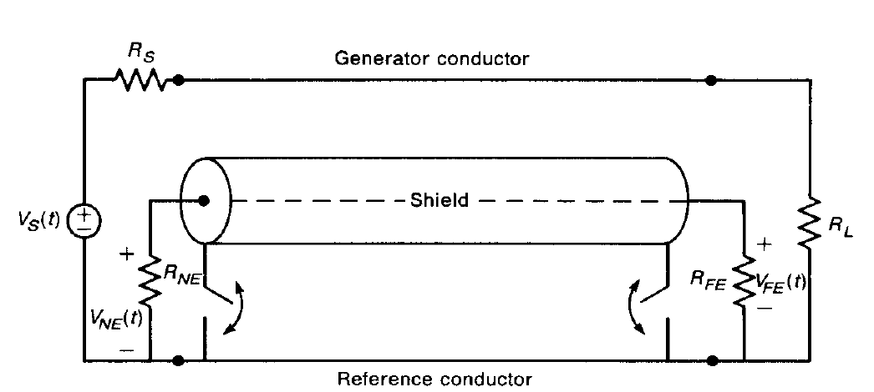
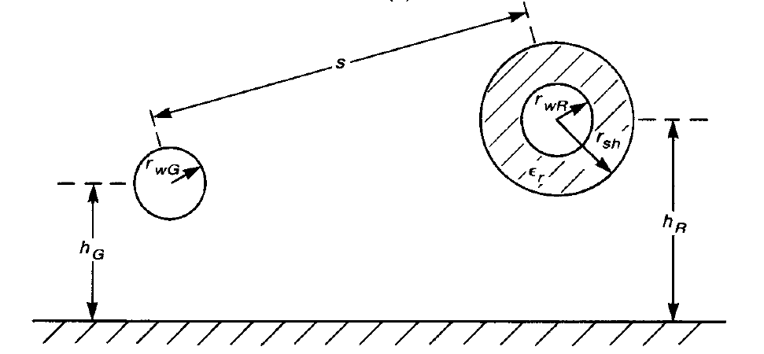
General Methods of Reducing Low-Frequency Interference:
Use of Shielded Wires

Slide 5
Per-Unit-Length Parameters: Inductances
Self-inductance of the generator circuit:
Similarly, the self-inductance of the
shield – ground plane circuit:
where r_{sh} is the shield inner radius and t_{sh} is the shield thickness.
The self-inductance of the receptor circuit is computed as the self-inductance of a wire above ground (the receptor voltage is defined between the receptor wire and the ground plane and the receptor current returns through the ground plane):

Slide 6
Per-Unit-Length Parameters: Inductances
The mutual inductance between the generator wire and
the shield L’_{GS} and that between the generator
wire and the receptor wire L’_{GR} are given by
In order for these to be equal, we assume that the shield and generator wire are widely separated, which is implicit in all these results.
The mutual inductance between the shield and receptor wire circuit is:
Hence, the mutual inductance between the receptor wire – ground plane circuit and the shield – ground plane circuit L’_{RS} is identical to the self-inductance of the shield-ground plane circuit L’_{S}.
This result deserves further explanation
See next slide.

Slide 7
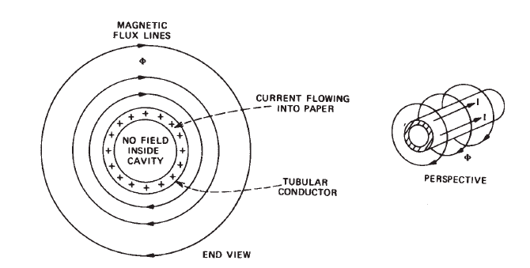
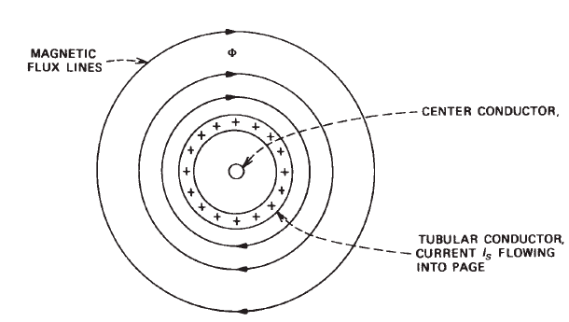
Per-Unit-Length Parameters: Inductances
Because all the flux produced by the shield current encircles the center conductor, the flux in these two equations is the same.

Slide 8
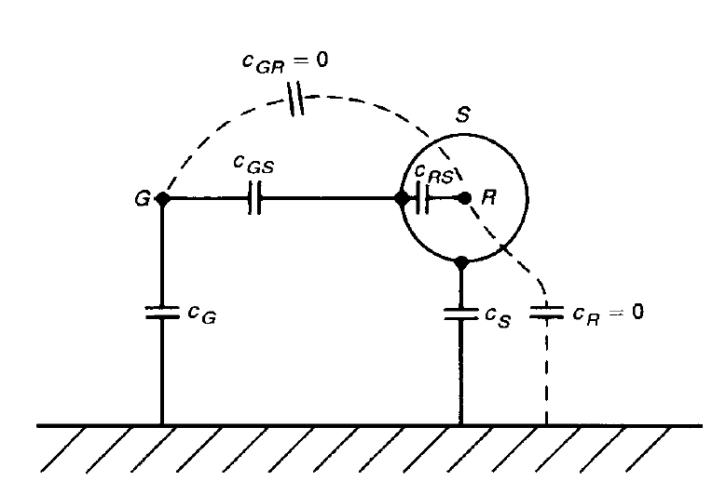
Per-Unit-Length Parameters: Capacitances
The capacitances can be obtained through the use of the reciprocal relationship between inductance and capacitance matrices. The medium interior to the shield can have a dielectric ε_{r}≠1 , whereas the medium outside is assumed to be free space.
The capacitance between the shield and receptor wire is the same as for a coaxial cable:
‘
‘
‘
‘
‘
‘
The other capacitances can be found using the reciprocal relationship for conductors in a homogeneous medium by considering only the generator wire and the shield

Slide 9
Capacitive Coupling: No Shield
Let us consider first the capacitive coupling. We have retained only the mutual capacitance and ignored the self capacitances.
The induced voltage is given by
When ωC_{GR}Z_{ab}<<1, we will have
V₁
C_{GR}
C_{GR}
which correspond to the weak-coupling
approximation
V₁

Slide 10
Capacitive Coupling: With Shield
The capacitive induced voltage is given by
V₁
C_{GS}
when ωC’_{o}Z_{ab}<<1,
C_{GS}

Slide 11
Capacitive Coupling: With Shield
The capacitive induced voltage is given by
V₁
C_{GS}
C_{GS}
V₁

Slide 12
Capacitive Coupling: With Shield
Z
Z
s
s
+
+
V
V
V₁
Z
S
Z
S
L
V
L
V
G
G
C_{GS}
C
C
o
o
The shield inherently eliminates capacitive coupling so long as it is grounded at either end.
C
C
R
R
S
S
Z
Z
Z
a
Z
a
b
b
C_{GS}
C
C
C
o
C
o
R
R
S
S
Z
Z
=
=
Z
Z
/
/
/
/
Z
Vshield=0
Z
V
V
=
=
V
V
V
V
a
a
b
b
a
a
b
b
a
a
b
G
b
G

Slide 13
Inductive Coupling: No Shield
Again, retaining only the mutual inductance and ignoring the self inductances, we have
V₁
L_{GR}
jωL_{GR}I_{G}
Z_{a}
V_{a}
V_{b}
Z_{b}

Slide 14
Inductive Coupling: With Shield
Question:
A shield must be grounded at both ends in order to eliminate inductive coupling
Answer:
A: True
B: False

Slide 15
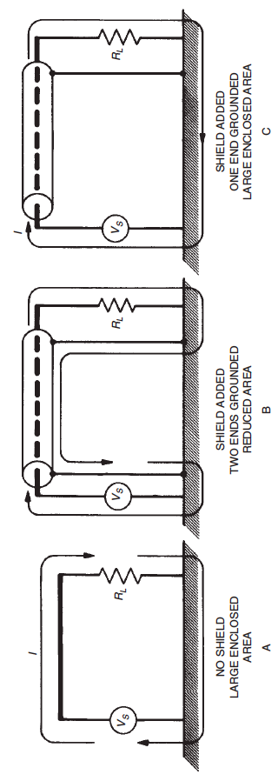
Inductive Coupling: With Shield

Slide 16
Inductive Coupling: With Shield
I₁₌I_{G}
Z
s
I
G
+
V
S
V₁
Z
L
V
G
I
s
Z
a
Z
b

Slide 17
Inductive Coupling: With Shield
Equivalent circuit for the receptor line:
Receptor wire
Recall that:
Shield
L_{GR} = L_{GS} = M
L_{RS} = L_{sh}
R_{sh} and L_{sh} are the resistance and inductance of the shield, respectively.

Slide 18
Inductive Coupling: With Shield
The induced voltages on the receptor line when the shield is present:

Slide 19
Inductive Coupling: With Shield
Weak Coupling Approximation
Shield removed,
Not grounded
at both ends
20 dB/decade
Shield grounded
at both ends

Slide 20
Inductive Coupling: Multiple Shield
No shield
One shield
Both shielded

Slide 21
Effect of Shield on Inductive and Capacitive Coupling
Summary
The presence of a floating shield does not have any effect on the capacitive and inductive coupling.
If the shield is grounded at least at one end, the capacitive coupling contribution is zero.
The inductive coupling is affected by the shield only if the shield is grounded at both ends and the frequency is greater than the break frequency, (f > f_{o} = R_{sh}/(2πL_{sh})).

Slide 22
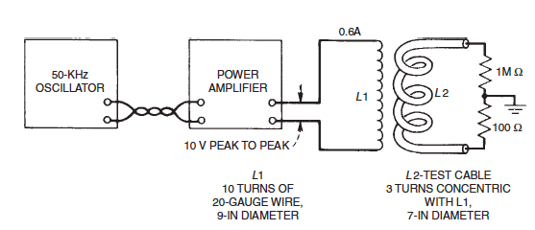
Experiment on Inductive Coupling
The shielding properties of various cable configurations were measured anc compared.
The frequency (50 kHz) is greater than 5 times the shield cutoff frequency for all the bales tested.
Here is the test setup:
The results are shown in the following slides

Slide 23
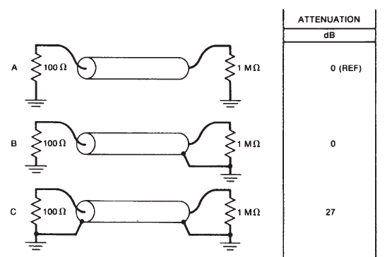
Experiment on Inductive Coupling
The reference case

Slide 24
Experiment on Inductive Coupling
The shield is grounded only at one end: no effect on the magnetic field coupling

Slide 25
Experiment on Inductive Coupling
The shield provides magnetic field protection because the frequency is above the shield cutoff frequency

Slide 26
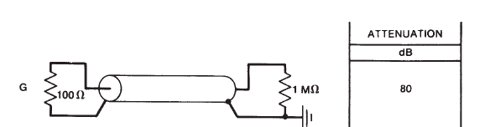
Experiment on Inductive Coupling
What about in this case?

Slide 27
General Methods of Reducing Low-Frequency Interference:
Use of Twisted Wires
A twisted pair is a bifilar helix.
Replacing a receptor wire with a twisted pair and using one wire of the pair as the return for the receptor circuit inherently reduces inductive or magnetic field coupling.

Slide 28
General Methods of Reducing Low-Frequency Interference:
Use of Twisted Wires
The twisted pair can be approximated as a cascade of alternating rectangular loops in the vertical (or in the horizontal) plane.
Assuming again that the generator and receptor circuits are weakly coupled, we can use the inductive-capacitive coupling model.
Length of the half-twist

Slide 29
Recall: Equivalent Inductive-Capacitive Circuit for Weak Coupling

Slide 30
Twisted Wires: Inductive Coupling
Inductive Coupling

Slide 31
Twisted Wires: CapacitiveCoupling
Capacitive Coupling

Slide 32
Twisted Wires: Self and Mutual Inductances
receptor
source

Slide 33
Twisted Wires: Capacitances

Slide 34
Twisted Wires: Capacitances

Slide 35
Twisted Wires: Capacitive and Inductive Coupling

Slide 36
Coupling to an Unbalanced Twisted Pair
Receptor line

Slide 37
Coupling to an Unbalanced Twisted Pair: Capacitive Coupling
For one period of the ‘untwisted’ line:
For the whole line:
Weak coupling
Identical to the untwisted case!

Slide 38
Coupling to an Unbalanced Twisted Pair: Inductive Coupling
Even number of half-twists:
Inductive coupling is zero
Odd number:
Weak
Coupling

Slide 39
Coupling to an Unbalanced Twisted Pair:
Predominant Inductive Coupling
Inductive (untwisted)
Capacitive (untwisted)
Capacitive (twisted)
Inductive (twisted)

Slide 40
Coupling to an Unbalanced Twisted Pair:
Predominant Capacitive Coupling
Capacitive (untwisted)
Capacitive (twisted)
Inductive (untwisted)
Inductive (twisted)

Slide 41
Coupling to a Balanced Twisted Pair

Slide 42
Coupling to a Balanced Twisted Pair

Slide 43
Coupling to a Balanced Twisted Pair
The inductive coupling is unchanged from the unbalanced case.
However, because of the balanced loads, the capacitive coupling contributions cancel out.
Thus, the effect of balancing is to eliminate the capacitive coupling contribution.

Slide 44
Coupling to a Balanced Twisted Pair:
Predominant Capacitive Coupling
Capacitive (twisted unbalanced)
Inductive
(balanced, unbalanced)
Capacitive (twisted balanced)

